Slide 1
Chapter 3: Processes
NARZU TARANNUM(NAT)
LECTURER
DEPT. OF CSE, BRAC UNIVERSITY

Slide 2
Chapter 3: Processes
Process Concept
Process Scheduling
Cooperating Processes
Interprocess Communication

Slide 3
Process Concept
An operating system executes a variety of programs
Textbook uses the terms job and process almost interchangeably
Process – a program in execution; process execution must progress in sequential fashion
A process includes:
  program counter
  stack
  data section

Slide 4
Process Control Block (PCB)
Information associated with each process
Process id/number
Process state
Program counter
CPU registers
CPU scheduling information/ Priority
Memory-management information/ protection
List of open files
I/O status information

Slide 5

Process Control Block (PCB)

Slide 6
Process State
As a process executes, it changes state
  new: The process is being created
  ready: The process is waiting to be assigned to a processor.
  running: Instructions are being executed
  waiting: The process is waiting for some event to occur
  terminated: The process has finished execution

Slide 7

Diagram of Process State

Slide 8
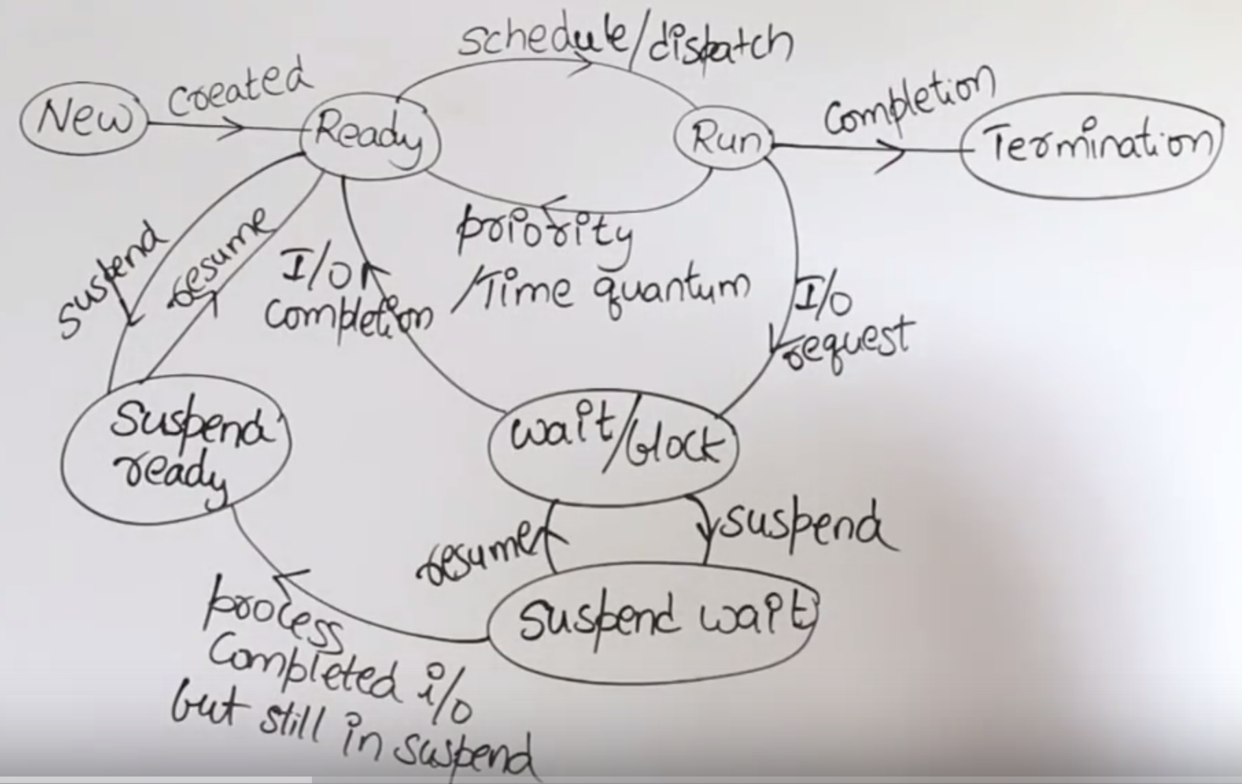
Process Scheduling

Slide 9
Context Switch
When CPU switches to another process, the system must save the state of the old process and load the saved state for the new process
Context-switch time is overhead; the system does no useful work while switching
Context of a process represented in the PCB
  The more complex the OS and the PCB ➔ the longer the context switch
Time dependent on hardware support

Slide 10

CPU Switch From Process to Process

Slide 11
Schedulers
Long-term scheduler (or job scheduler) – selects which processes should be brought into the ready queue
Short-term scheduler (or CPU scheduler) – selects which process should be executed next and allocates CPU

Slide 12
Schedulers (Cont.)
Short-term scheduler is invoked very frequently (milliseconds) ⇒ (must be fast)
Long-term scheduler is invoked very infrequently (seconds, minutes) ⇒ (may be slow)
The long-term scheduler controls the degree of multiprogramming
Long-term scheduler strives for good process mix
Processes can be described as either:
  I/O-bound process – spends more time doing I/O than computations.
  CPU-bound process – spends more time doing computations.

Slide 13

Mid-term scheduler
sometime it can be advantageous to remove process from the memory and thus to reduce the degree of multi-programming.
  Remove process from memory, store on disk, bring back in from disk to continue execution: swapping

Slide 14
Process Scheduling Queues
Maximize CPU use, quickly switch processes onto CPU for time sharing.
Process scheduler selects among available processes for next execution CPU.
Maintains scheduling queues of process
  Job queue – set of all processes in the system
  Ready queue – set of all processes residing in main memory, ready and waiting to execute
  Device queues – set of processes waiting for an I/O device
  Processes migrate among the various queues

Slide 15

Representation of Process Scheduling

Slide 16
Process Creation
Parent process creates children processes, which, in turn create other processes, forming a tree of processes
Resource sharing
  Parent and children share all resources
  Children share subset of parent’s resources
  Parent and child share no resources
Execution
  Parent and children execute concurrently
  Parent waits until children terminate

Slide 17
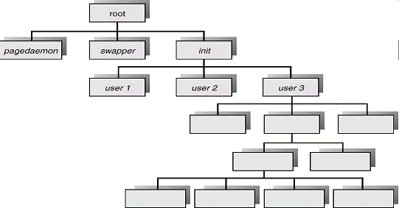
Processes Tree on a UNIX System

Slide 18
Interprocess Communication
Processes within a system may be independent or cooperating
Independent process cannot affect or be affected by the execution of another process
Cooperating process can affect or be affected by the execution of another process
  Advantages or reason of cooperating process
    Information sharing
    Computation speed-up
    Modularity
    Convenience

Slide 19
Interprocess Communication
Cooperating process can affect or be affected by other processes, including sharing data, Information sharing.
Cooperating processes need interprocess communication (IPC)
  IPC provides a mechanism to allow processes to communicate and to synchronize there actions.
    Two models of IPC
      Shared memory
      Message passing

Slide 20

Interprocess Communication (IPC) Models
a) Message Passing b) Shared Memory
Notes:
Shared memory – faster; good for large data; must be in the same machine
Message passing – good for processes running on different machines in a network; good for smaller data

Slide 21
Shared-Memory
Establish a region of shared memory
Read and write data in the shared area
Processes responsible for synchronization
  Must ensure that same memory location is not being modified by multiple processes at the same time

Slide 22
Message-Passing systems
Mechanism for processes to communicate and to synchronize their actions
Message system – processes communicate with each other without resorting to shared variables
IPC facility provides two operations:
  send(message) – message size fixed or variable
  receive(message)
If P and Q wish to communicate, they need to:
  establish a communication link between them
  exchange messages via send/receive

Slide 23
End of Chapter 3

